Slide 1
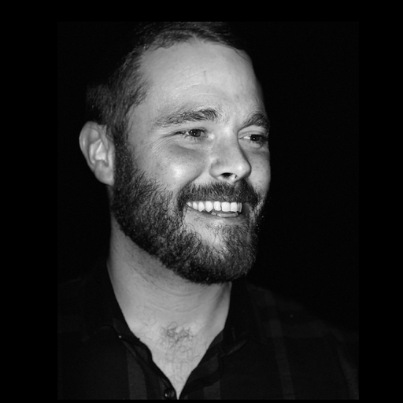


Movie Studio Consultants
Presenters:
Sean Evans
Kaelyn Paris
Qi Cai

Slide 2

Overview /
Business Understanding
Our goal is providing three recommendations of filmmaking characteristics to best gain profit for the movie studio.

Slide 3
Data Understanding
Data Cleaning
Data Source: IMDb Database, The Numbers budget data
Data Exploration
Select and Identify patterns in Useful Columns
Data Analysis
Extract return percentage
Center analysis around return percentage

Slide 4
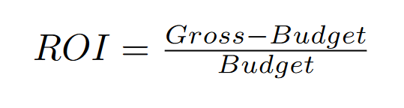


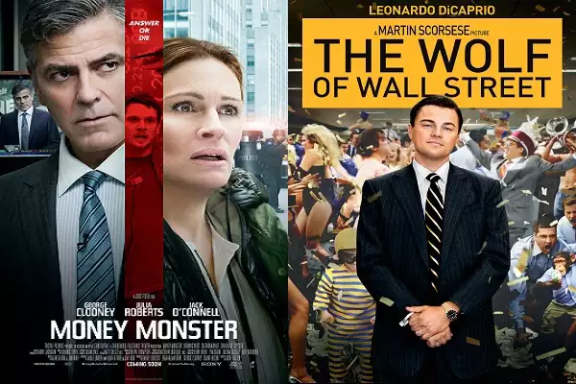
Method
Budget
22
15
Notes:
Merge datasets
Calculate return percentage for movies given gross and budget info
Investigate relationships between top return movies and their genres, movie lengths, and directors.

Slide 5
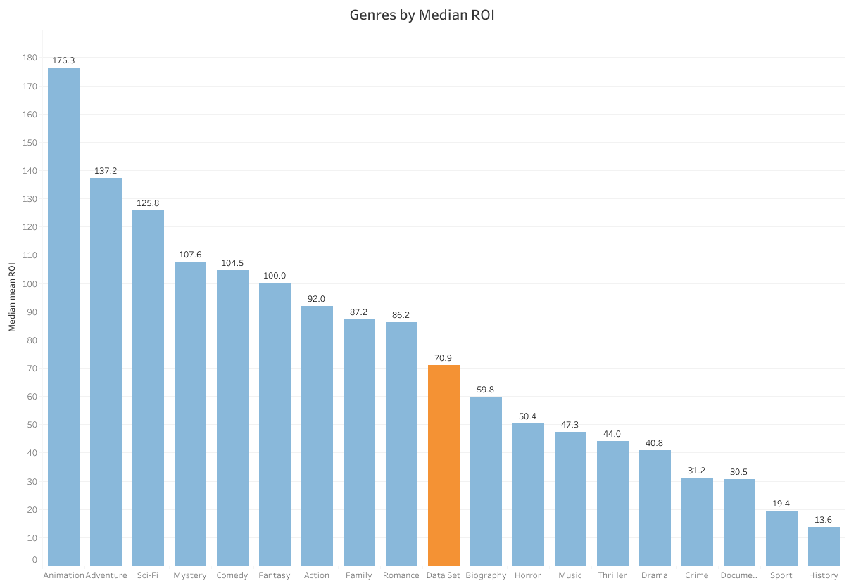

Slide 6
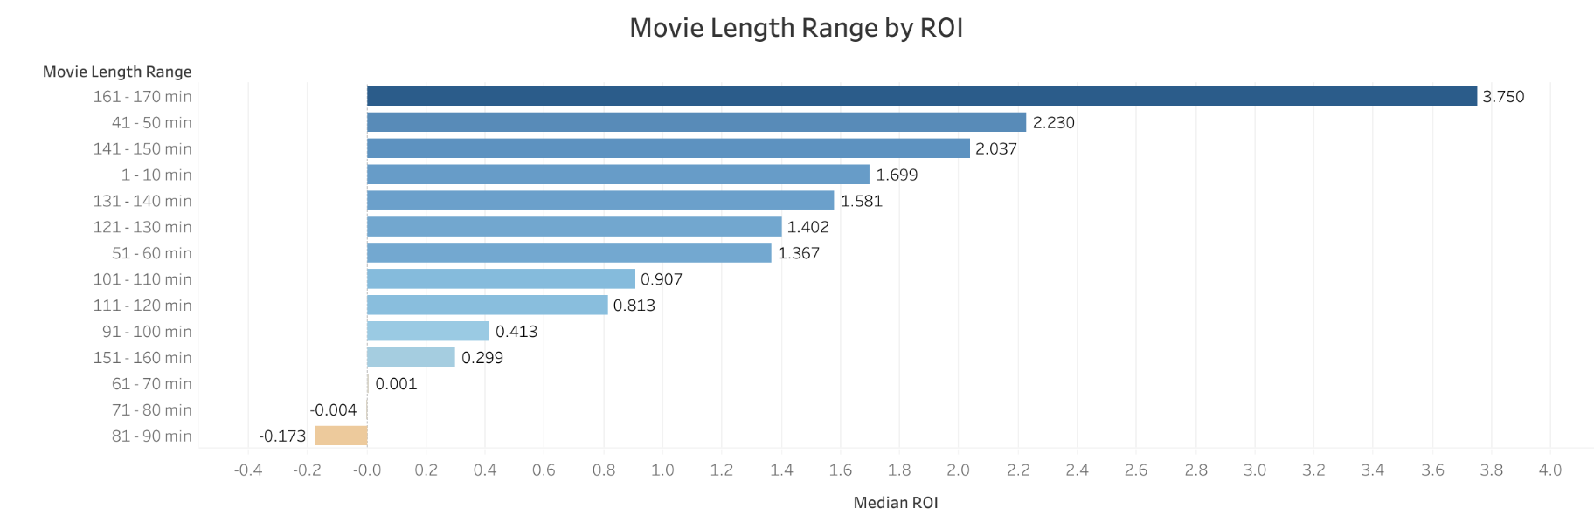
Notes:
50-60 minutes

Slide 7
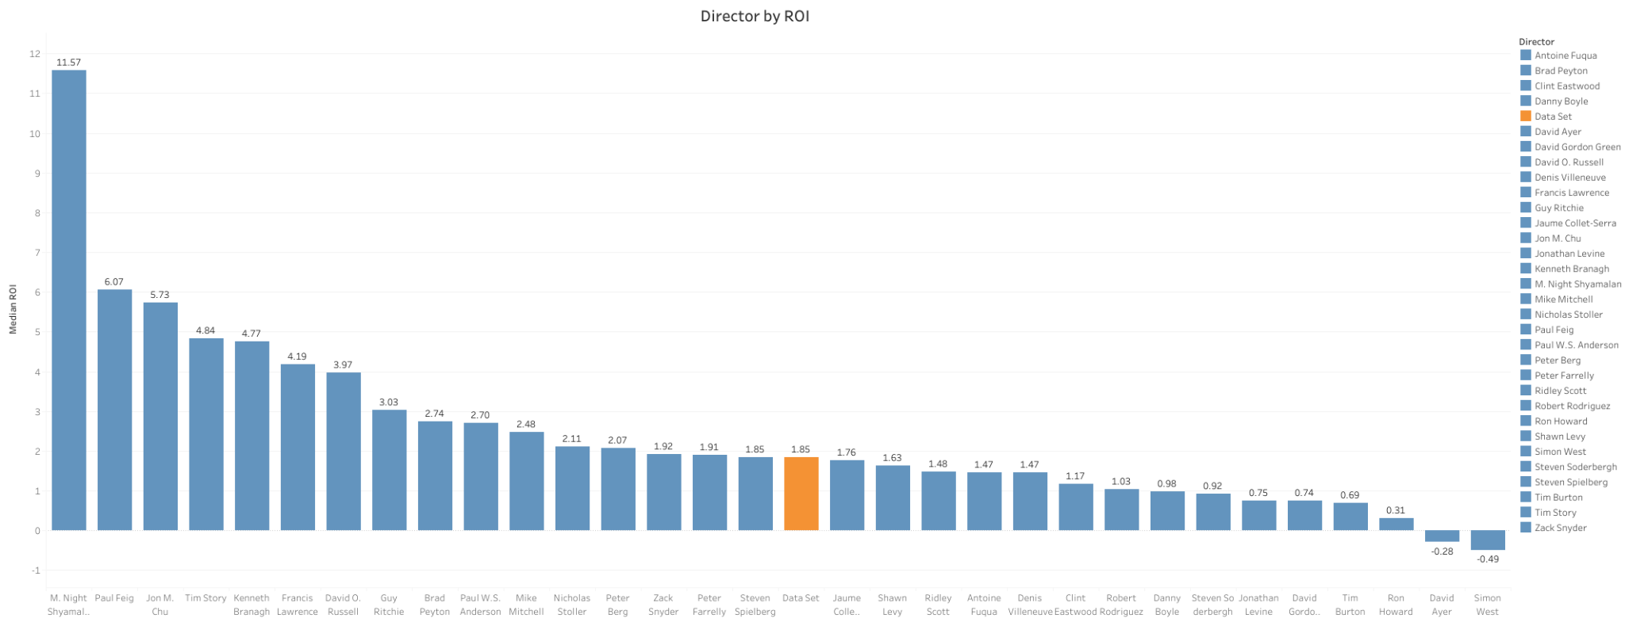

Slide 8
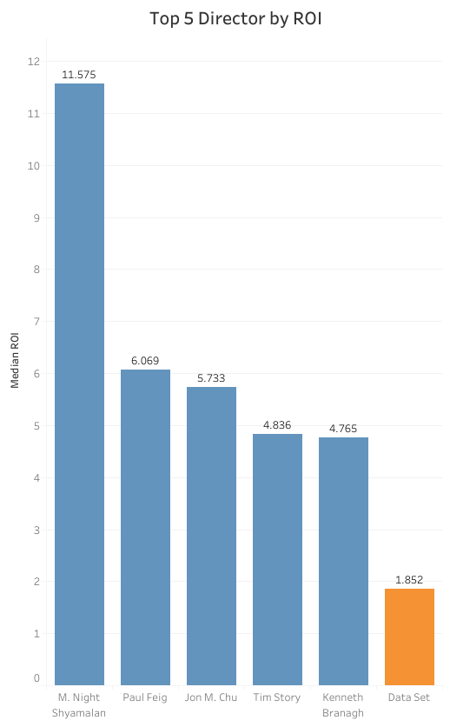

Slide 9

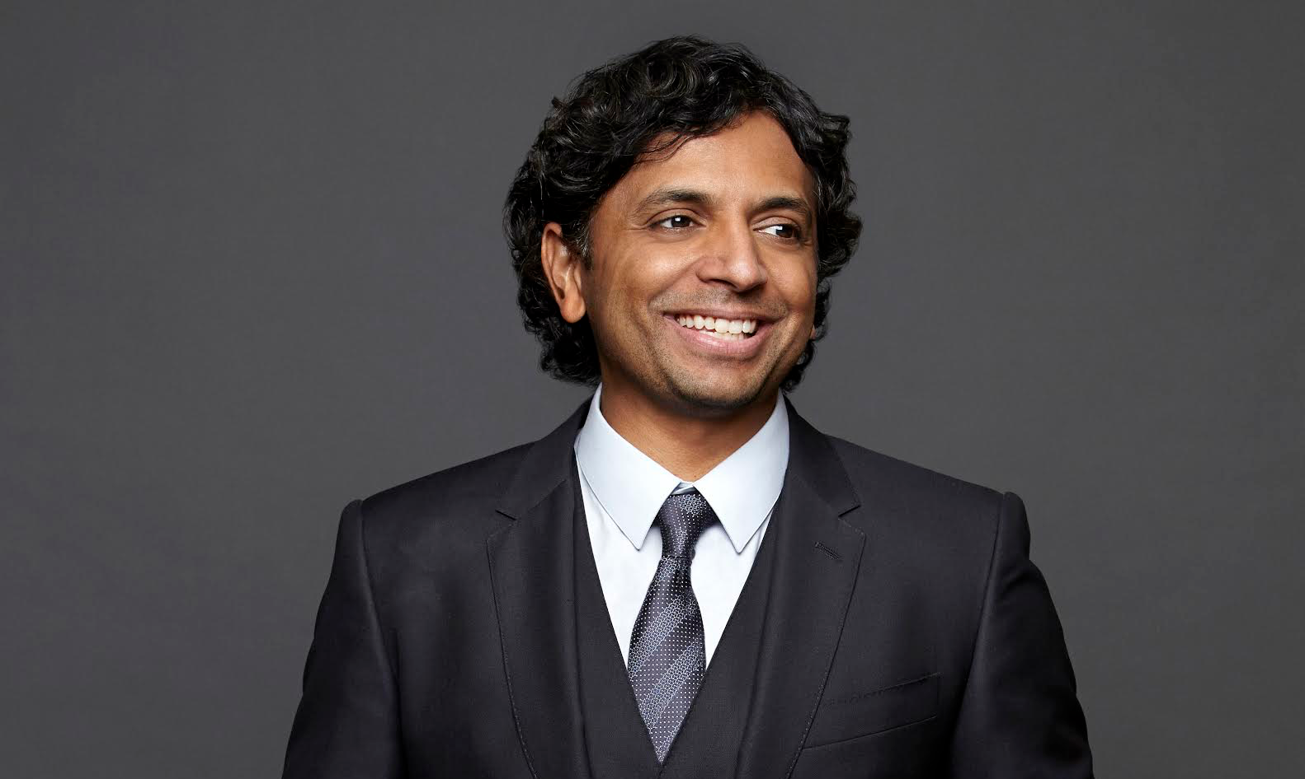
3 Recommendations
Genre
Genres
Action
Runtime
161-170 Minutes Runtime
Director
M. Night Shyamalan

Slide 10


Thank you!
Kaelyn Parris
Qi Cai
Sean Evans
kaelyn-parris
qiechocai
sean-evans
kaelyn_parris@protonmail.com
qicai1995@gmail.com
sean.evans009@gmail.com

